Slide 1
P.R. GOVERNMENT COLLEGE (A), KAKINADA
Group: B.Sc. III Year
Subject: Electronics
Semester: 5
Paper : 5
Title of the paper: Microprocessor (Intel 8085)
w.e.f. 2018 - 19 ADMITTED BATCH

Slide 2
Topic : Introduction to Microprocessor

Slide 3
Introduction
A computer is a programmable machine that receives input, stores and manipulates data or information, and provides output in a useful format.

Slide 4
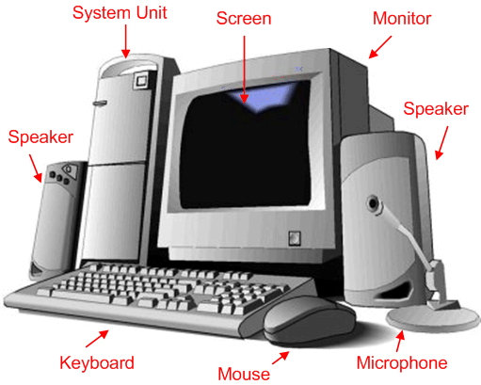
DIAGRAM OF A COMPUTER SYSTEM
A computer is a programmable machine that receives input, stores and manipulates data or information, and provides output in a useful format.

Slide 5
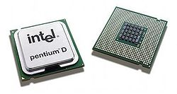
Basic component of micro computer
Central Processing Unit: The CPU consists of ALU (Arithmetic and Logic Unit), Register unit and control unit. The CPU retrieves stored instructions and data word from memory; it also deposits processed data in memory.
ALU (Arithmetic and Logic Unit): This section performs computing functions on data. These functions are arithmetic operations such as additions subtraction and logical operation such as AND, OR, rotate etc. Result are stored either in registers or in memory or sent to output devices.
Pentium D dual core processors

Slide 6
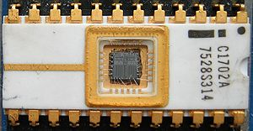
Memory
Physical devices used to store data or programs (sequences of instructions) on a temporary or permanent basis for use in an electronic digital computer.
Computer main memory comes in two principal varieties: random-access memory (RAM) and read-only memory (ROM).
RAM can be read and written to anytime the CPU commands it, but ROM is pre-loaded with data and software that never changes, so the CPU can only read from it.
ROM is typically used to store the computer's initial start-up instructions.
In general, the contents of RAM are erased when the power to the computer is turned off, but ROM retains its data indefinitely.

Slide 7
DATA SIZE
Bit: A bit is a single binary digit.
Nibble | 4 bit
Byte | 8 bit
Word | 16 bit
Long word | 32 bit

Slide 8
I/O Unit
Input/output (I/O), refers to the communication between an information processing system (such as a computer), and the outside world possibly a human, or another information processing system.
Inputs are the signals or data received by the system, and outputs are the signals or data sent from it.
Devices that provide input or output to the computer are called peripherals
On a typical personal computer, peripherals include input devices like the keyboard and mouse, and output devices such as the display and printer. Hard disk drives, floppy disk drives and optical disc drives serve as both input and output devices. Computer networking is another form of I/O.

Slide 9
Evolution of Microprocessor

Slide 10
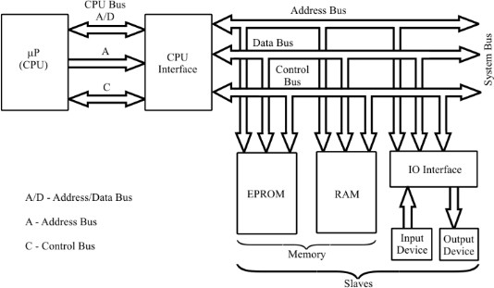
BLOCK DIAGRAM OF A MICROPROCESSOR BASED SYSTEM
Basic computer system consist of a Central processing unit (CPU), memory (RAM and ROM), input/output (I/O) unit.
Block diagram of a basic computer system

Slide 11
FUNCTIONS OF MICROPROCESSOR BASED SYSTEM
In this system, the microprocessor is the master and all other peripherals are slaves.
The master controls all peripherals and initiates all operations.
The buses are group of lines that carry data, address or control signals.
The CPU interface is provided to demultiplex the multiplexed lines, to generate the chip select signals and additional control signals.
The system bus has separate lines for each signal.
The EPROM memory is used to store permanent programs and data.
The RAM memory is used to store temporary programs and data.

Slide 12
Bus organization of Microprocessor based system
Bus: A bus is a group of wires/lines that carry similar information.
System Bus: The system bus is a group of wires/lines used for communication between the microprocessor and peripherals.
Address Bus:
It is a group of wires or lines that are used to transfer the addresses of Memory or I/O devices.
It is unidirectional. For example, if an Address bus have 16 bits.
Microprocessor can transfer maximum 16-bit address which means it can address 65,536 different memory locations.
Address bus is multiplexed with 8-bit data bus. So, the most significant bits (MSB) of address goes through Address bus (A₇-A₁₅) and LSB goes through multiplexed data bus (AD₀-AD₇).

Slide 13
Bus organization of Microprocessor based system
Data Bus: The data bus is used to transfer data between memory and processor or between I/O device and processor.
For example, an 8-bit processor will generally have an 8-bit data bus and a 16-bit processor will have 16-bit data bus.
Control Bus: The control bus carry control signals, which consists of signals for selection of memory or I/O device from the given address, direction of data transfer and synchronization of data transfer in case of slow devices.

